Slide 1
MOTION GESTUTRE CONTROLLED VEHICLE -USING aRDUINO nano
Group : 07

Slide 2
Abstract:-
.
An electro-mechanical system that can be operated by a computer program thereafter can be controlled by human hand motion.
A Gesture controlled vehicle can is a kind of robot which is capable of carrying complex actions automatically or under human supervision.
The robot and the gesture instrument are connected wirelessly through radio waves. We can control the car using sensors connected to the hand glove.
The mechanisms involved the rotation of both forth & rear wheels of left and right side to move in the anticlockwise direction and the other pairs is to rotate in the clockwise direction which makes the car to rotate about its own axis without any kind of forward and backward motion.
This mechanism can take a sharp turn without any difficulty.

Slide 3
Objective:-
The main objective of this project is to control the car using human gesture and sensed with the help of an accelerometer. It is coded in such a way that the required actions for the human gesture are done.
This system uses a RF transceiver and receiver module for the wireless communication to change the direction and speed of the vehicle.
For the hardware, customised Arduino will give the control over the motors that are used to to run the robotic car.
The project helps us to control robotic arms using gesture control system and has been widely used under the Artificial Intelligence.
The proposed model will be helpful and avoid Danger for the people working in the hazardous areas.
.

Slide 4
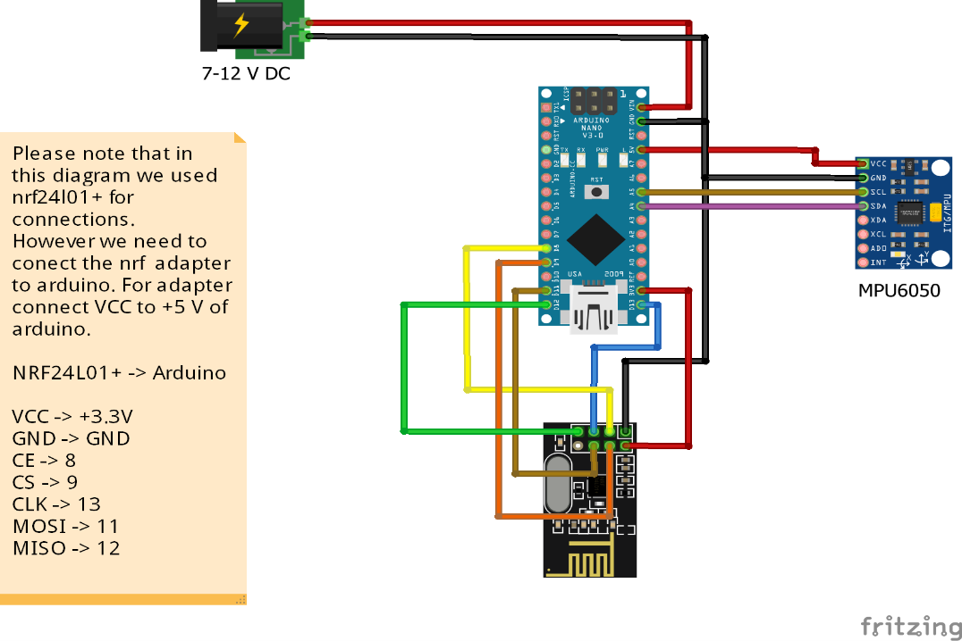
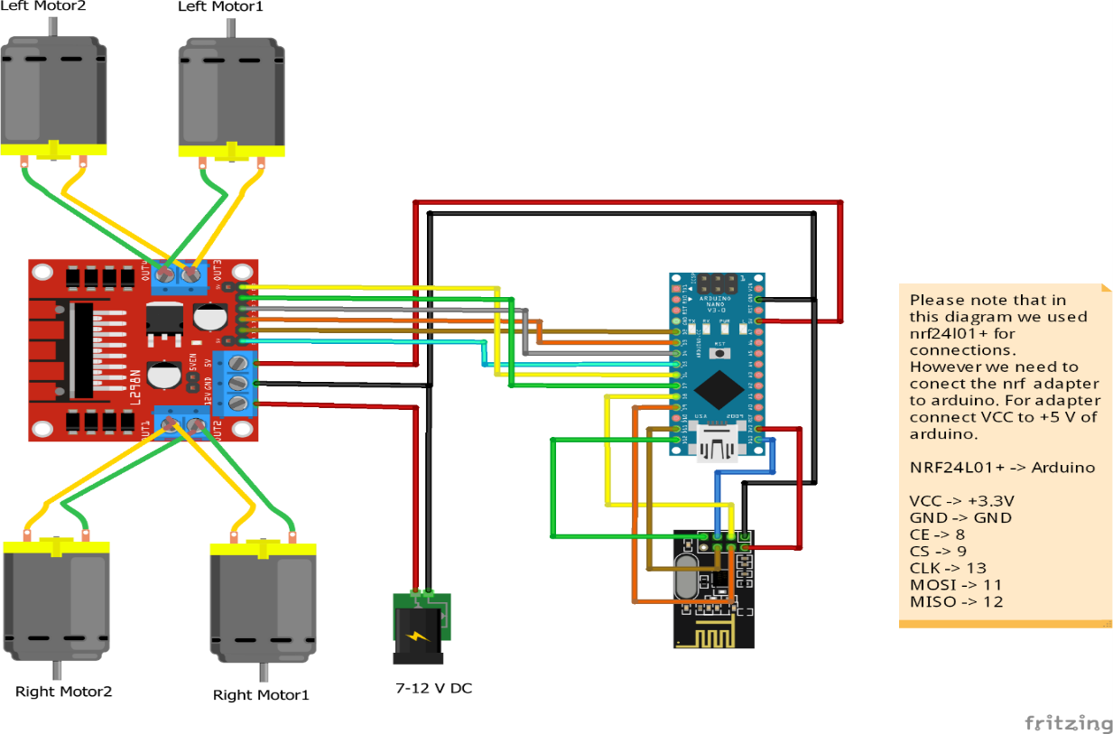
CIRCUIT DIAGRAM:-
TRANSMITTER CIRCUIT
RECEIVER CIRCUIT
.

Slide 5
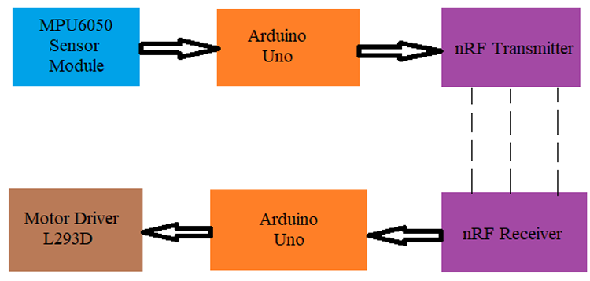
WORKING FUNCTION:-
The first part is getting data from the MPU6050 Accelerometer Gyro sensor by the Arduino. The Arduino continuously acquires data from the MPU6050 and based on the predefined parameters. It sends a data to the RF-Transmitter.
The second part if the project is the Wireless Communication between the RF Transmitter and RF Receiver. The RF Transmitter upon receiving data from Arduino (through the Encoder IC), transmits it through the RF Communication to the RF Receiver.
Finally, the third part of the project is
decoding the Data received by the RF
Receiver and sending appropriate signals
to the Motor Driver IC, which will activate
the wheels of the Robot/Car.
Note: We are using arduino nano instead of Arduino UNO.
.

Slide 6
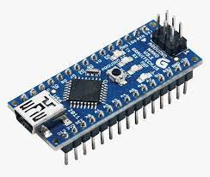
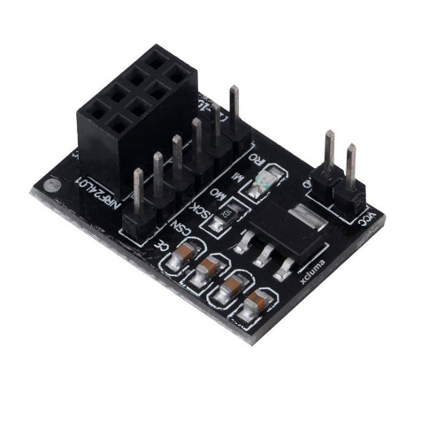
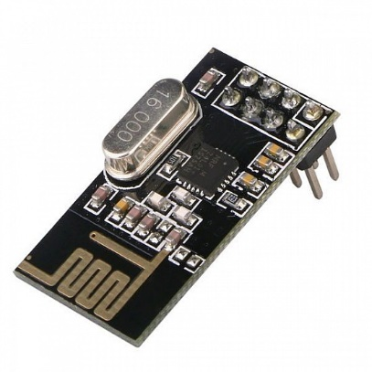
Components details:-
Transceiver module- NRF24L021+
The NRF24L01+ is a single chip 2.4GHz transceiver with an embedded baseband protocol engine (Enhanced shock burst).designed for ultra-low power wireless applications. The NRFL01 is designed for operation in the world wide ISM frequency band at 2.400-204835GHz
Arduino Nano:- The Arduino Nano is equipped with 30 male I/O headers, in a DIP-30-like configuration, which can be programmed using the Arduino Software integrated development
environment(IDE), which is common to all Arduino boards and running both online and offline. The board can be powered through a type-B mini-USB cable or from a 9 V battery.
NRF Adapter:-
NRF serial Adapter board allows you to plug in your NRF modules and communicate through serial communication.
These modules allow very reliable and simple communication between microcontrollers, computers, and system, really anything with a serial port!
Transceiver module- NRF24L021+
NRF24L01+ is a single chip 2.4GHz transceiver with an embedded baseband protocol engine (Enhanced shock burst).designed for ultra-low power wireless applications.
The NRFL01 is designed for opThe eration in the world wide ISM frequency band at 2.400-204835GHz
.

Slide 7
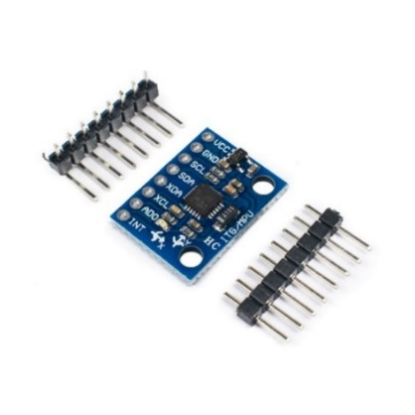
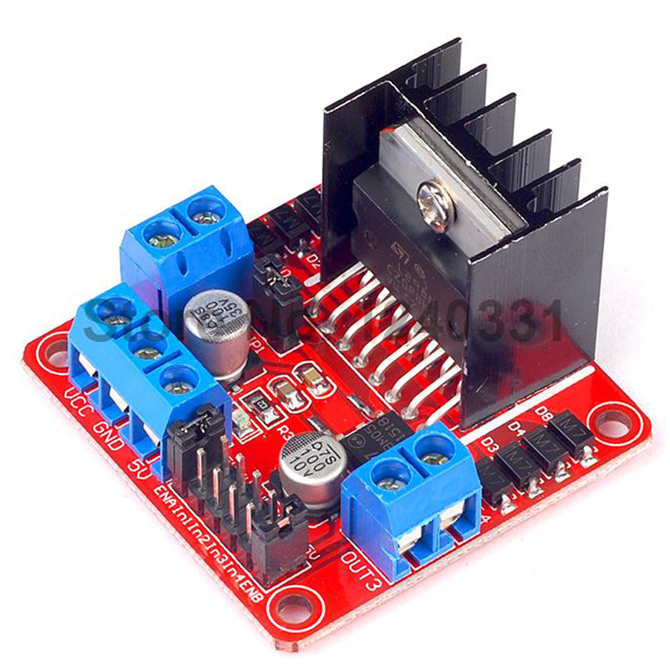
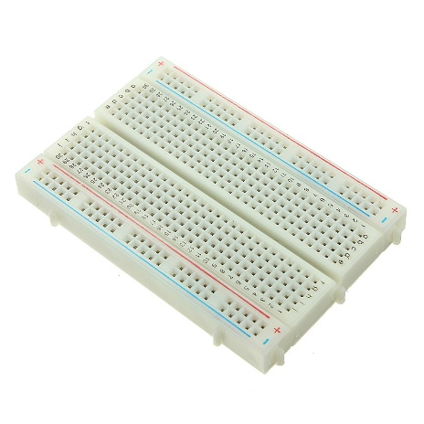
.
MPU6050 Module:-
MPU- 6050 Six-Axis (Gyro+ Accelerometer) MEMS Motion Tracking Device.
The MPU-6050 parts are the world’s first Motion Tracking devices designed for the
low power, low cost, and high-performance requirements of smartphones, tablets and
wearable sensors
L298N MOTOR DRIVER:-
The L298N is a dual H-Bridge motor driver which allows speed and direction control of two DC motors at the same time. The module can drive DC motors that have voltages between 5 and 35V, with a peak current up to 2A.
BREADBOARD:-
A breadboard (sometimes called a plug block) is used for building temporary circuits.
It is useful to designers because it allows components to be removed and replaced easily.
It is useful to the person who wants to build a circuit to demonstrate its action, then to reuse the components in another circuit
.

Slide 8
ADVANTAGES :-
Easy to operate.
Low power consumption
User friendly.
Single equipment=multiple applications.
When extended further in the hardware section , numerous applications can be added.
One can able to control one’s slave robots just by hand gestures by this technology.
FUTURE SCOPES:-
Connect and communicate with physical devices: IoT facilities the communication between human and machine.
Faster and smart innovation: speed is very crucial aspect of any tool. Because of the use of sensors in IoT devices the required output is given in a good speed with great accuracy.
Smart sensing capabilities: sensors such as accelerometer can sense very minute vibration, so the device works very precisely and can be used for such works where errors must be minimised.
.

Slide 9
CONCLUSION:-
Gesture recognition is technology that uses sensors to read and interpret hand movements as commands
In this project using Arduino Gesture control system was implemented.
This project helps us to control robotic arms using gesture control system and has been widely used under AI (Artificial Intelligence) and upcoming technologies.
In Automotive industry, this capability allows drivers and passengers to interact with the vehicle –usually to control the infotainment system without touching any buttons or screens.
In the future it can be modified better to understand wireless futuristic technologies to communicate between robots and humans
.

